Slide 1

CAUSAL INFERENCE
FOR DATA SCIENTISTS
MAY 3, 2019

Slide 2
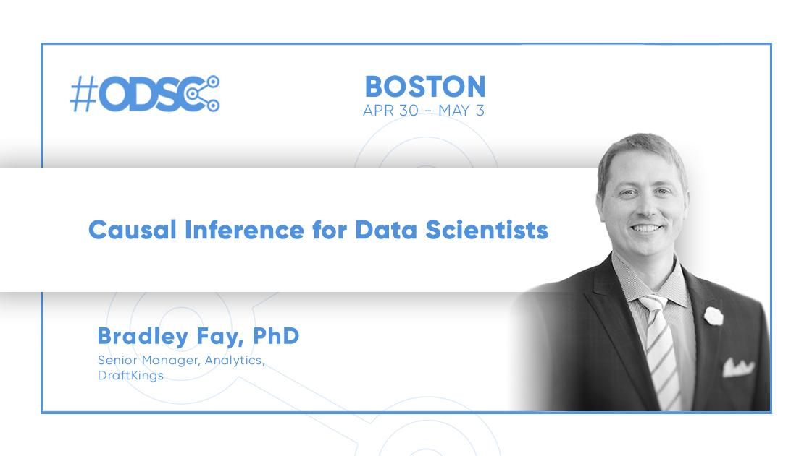

Slide 3
ABOUT DRAFTKINGS
DraftKings is a global sports technology and entertainment company that believes life is more fun with skin in the game. Its mission is to bring fans closer to the games they love via a unique combination of daily fantasy sports, sports betting and media platforms that, combined, deliver “The Game Inside The Game.” Founded in 2012 by Matt Kalish, Paul Liberman and Jason Robins, DraftKings is headquartered in Boston, MA, and offers daily fantasy sports contests across 12 professional sports in 8 countries including the U.S., Canada, U.K. and Australia. Operating pursuant to state regulations in New Jersey and Mississippi, DraftKings Sportsbook mobile and retail, allows players in the state to engage in betting for major U.S. and international sports.

Slide 4
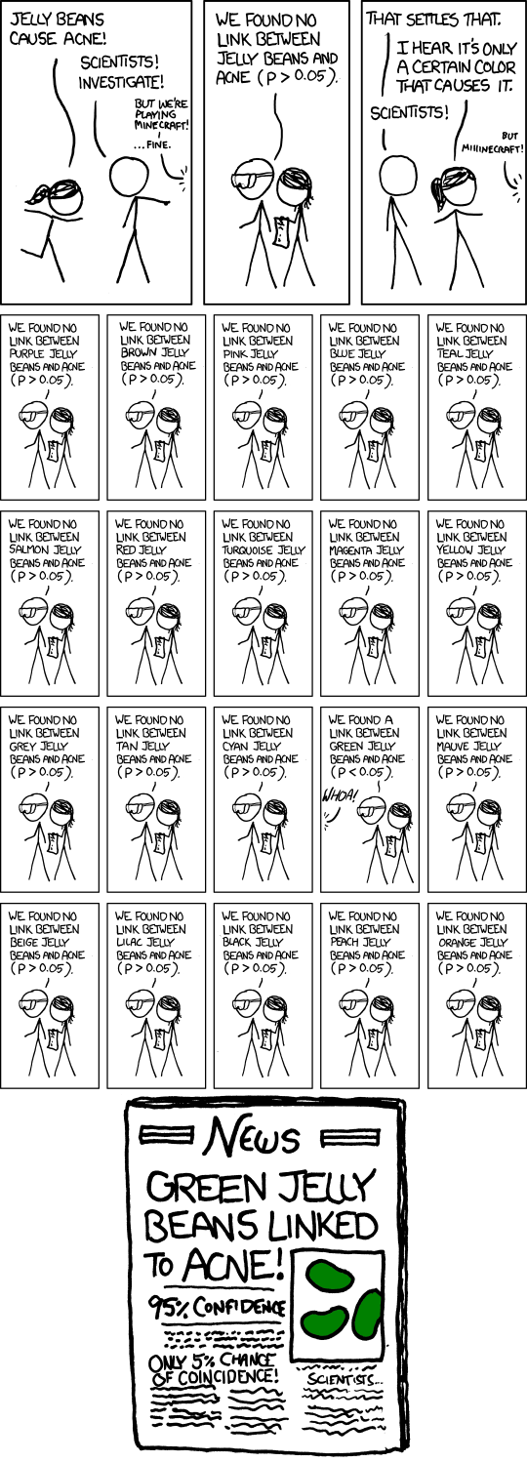

Slide 5
AGENDA
Framework for Causality
Tools:
The Ideal: Randomized Trial
Regression
Source of Bias!
More Tools:
Instrumental Variables
Difference in Differences
Concluding Thoughts

Slide 6
AUDIENCE ASSUMPTIONS
Some Understanding of Statistics (Mean, Cov, etc…)
Comfort with Math Notation
Comfort with Regression

Slide 7
Predictive vs. Causal
Prediction
Given my observations of X, my best guess for Y
Causation
If X had not occurred, what would Y have been?

Slide 8
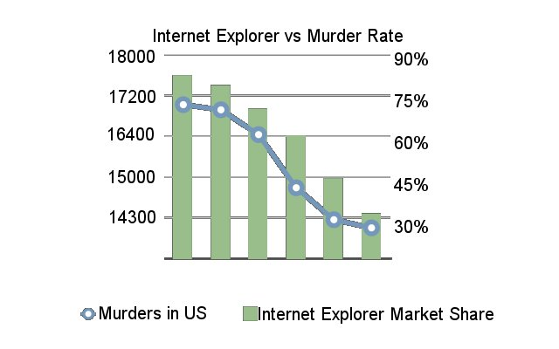
Correlation ≠ Causation

Slide 9


Correlation + Reasoning
=
Inferred Causation

Slide 10
“A rose by any other name…”
Impact Evaluation
Counterfactual Analysis
Uplift Modeling

Slide 11
Framework for Causality

Slide 12

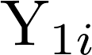
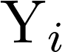


Rubin Causal Model
Truth
Counterfactual

Slide 13
Rubin Causal Model
S.table
U.nit
T.reatment
V.alue
A.ssumption
1
2

Slide 14

Potential Outcomes
Treatment Effect

Slide 15


Average Treatment Effects
...because Parallel Universes don’t exist...Maybe?

Slide 16
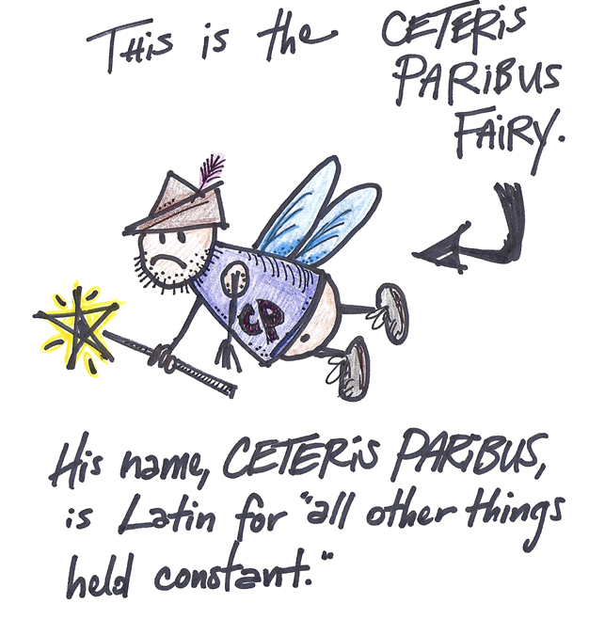
http://stickfigureeconomics.blogspot.com/2012/05/ceteris-paribus-fairy.html
Notes:
http://stickfigureeconomics.blogspot.com/2012/05/ceteris-paribus-fairy.html

Slide 17
Alternative Frameworks
Pearl Causality
Granger Causality
A
B
C
X_{t}
Y_{t+1}
D

Slide 18
Framework ➜ Action

Slide 19
The Ideal:
Randomized Trial

Slide 20






Random Assignment
=
Notes:
Ceteris Parabis Assumption holds true because we’re declaring that the two groups are identical in every way which means that there is an effectively zero probability that the groups are not equal

Slide 21

Random Assignment
Counterfactual
Truth
C.P. satisfied through Central Limit Theorem
Notes:
Insert walk of equations illustrating how Randomization eliminates selection bias and suggests our assumption of CP holds during analysis
Pg15
Don’t forget CLT and include the conditional independence of probability of treatment assignment and usage

Slide 22

Random Assignment
C.P & C.L.T. ➜ = 0

Slide 23
Robustness Checks
Understand experimental design
Compare groups on non-outcome variables
Hypothesize Confounders

Slide 24
Regression

Slide 25
Confounding Effects
Previous Behaviors

Slide 26

Find matches
Notes:
Logical walk.
Assigned Randomly (uncorrelated from any characteristics), but unluckily imbalanced when looking at a key variable.
Regression is solution

Slide 27
Regression
Assigned Treatment
⇣
Relevant Covariates
⇣
⇡
Impact of D,
Holding X constant

Slide 28
Robustness Checks
Compare effect with and without covariates
Stable estimates?
What if these fail…?

Slide 29
Sources of Bias!

Slide 30

Omitted Variable Bias
Previous Behaviors

Slide 31
Omitted Variable Bias
Previous Behaviors

Slide 32


Omitted Variable Bias

Slide 33
Selection Bias
When random assignment goes wrong
≠
Notes:
Logical walk.
Assigned Randomly (uncorrelated from any characteristics), but unluckily imbalanced when looking at a key variable.
Regression is solution

Slide 34
Selection Bias

Slide 35
Instrumental Variables

Slide 36


Example: Retargeting
Complete Randomization
Incomplete Treatment
Selection Bias!
Notes:
Instrument affects causal channel of interest
Independence requires instrument to be as good as randomized
Exclusion asserts that a SINGLE CAUSAL Channel connects the instruments to the outcomes
Pearl argues to do this mathematically using graphs, Econometrics requires us to make assumptions

Slide 37
Solving with Regression
Selection Bias!
Break Correlation?
Notes:
Instrument affects causal channel of interest
Independence requires instrument to be as good as randomized
Exclusion asserts that a SINGLE CAUSAL Channel connects the instruments to the outcomes
Pearl argues to do this mathematically using graphs, Econometrics requires us to make assumptions

Slide 38
Instrumental Variables
Requirements
Has a Causal effect on treatment
Independent of omitted variables
Exclusive path to causality
Notes:
Instrument affects causal channel of interest
Independence requires instrument to be as good as randomized
Exclusion asserts that a SINGLE CAUSAL Channel connects the instruments to the outcomes
Pearl argues to do this mathematically using graphs, Econometrics requires us to make assumptions

Slide 39

2-Stage Least Squares

Slide 40
Assumption Checks
Check for Strong corr. between Instrument and Causal Channel
Verify Independence by looking at covariates with/without instrument
Regress outcome on Instrument(s) and show near zero coefficient

Slide 41
Difference in Differences

Slide 42



Example: OOH Marketing
Notes:
Instrument affects causal channel of interest
Independence requires instrument to be as good as randomized
Exclusion asserts that a SINGLE CAUSAL Channel connects the instruments to the outcomes
Pearl argues to do this mathematically using graphs, Econometrics requires us to make assumptions

Slide 43
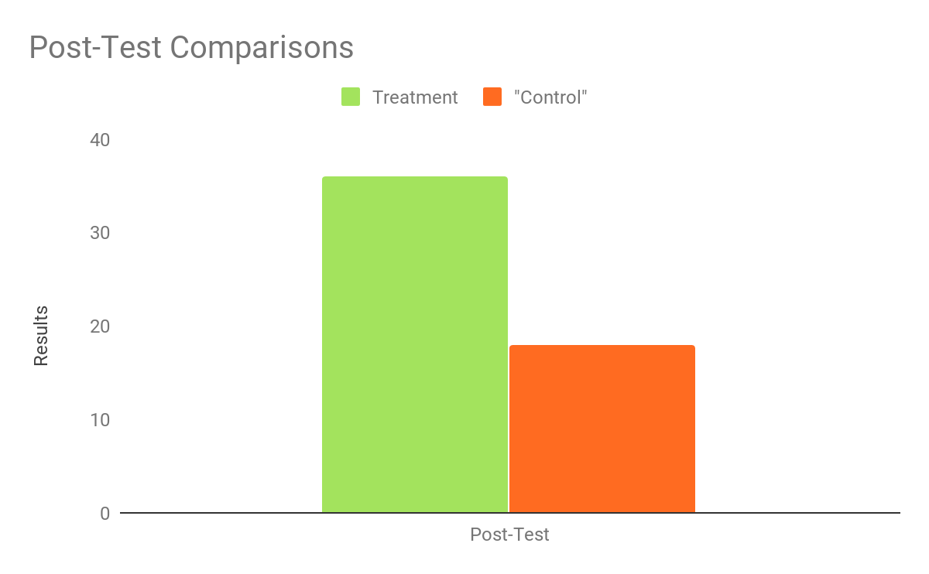
Compare Test vs Control

Slide 44
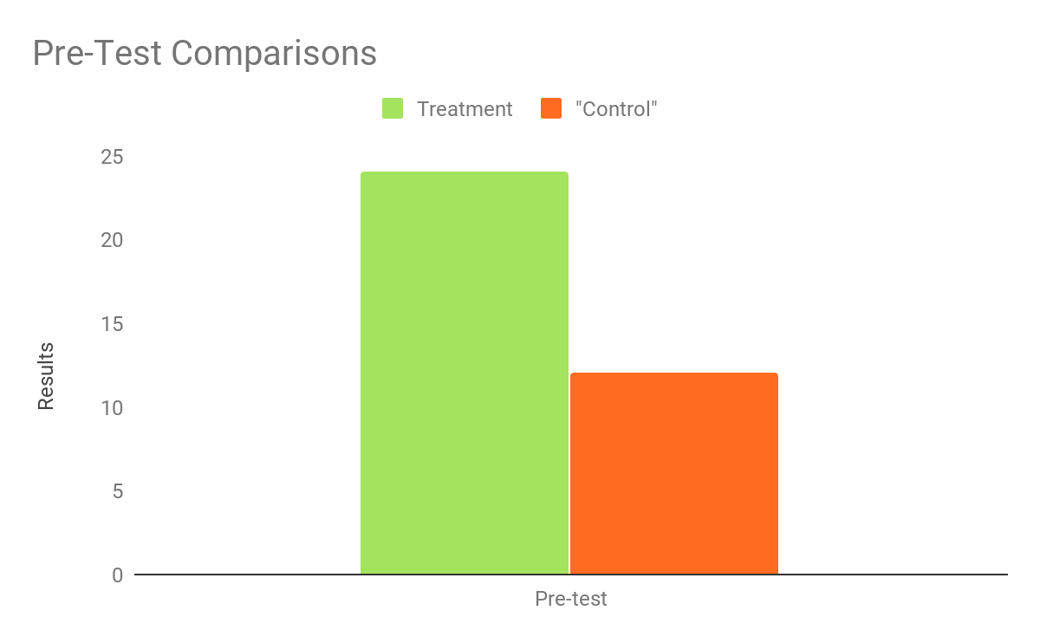

Checking Pre-test Results

Slide 45
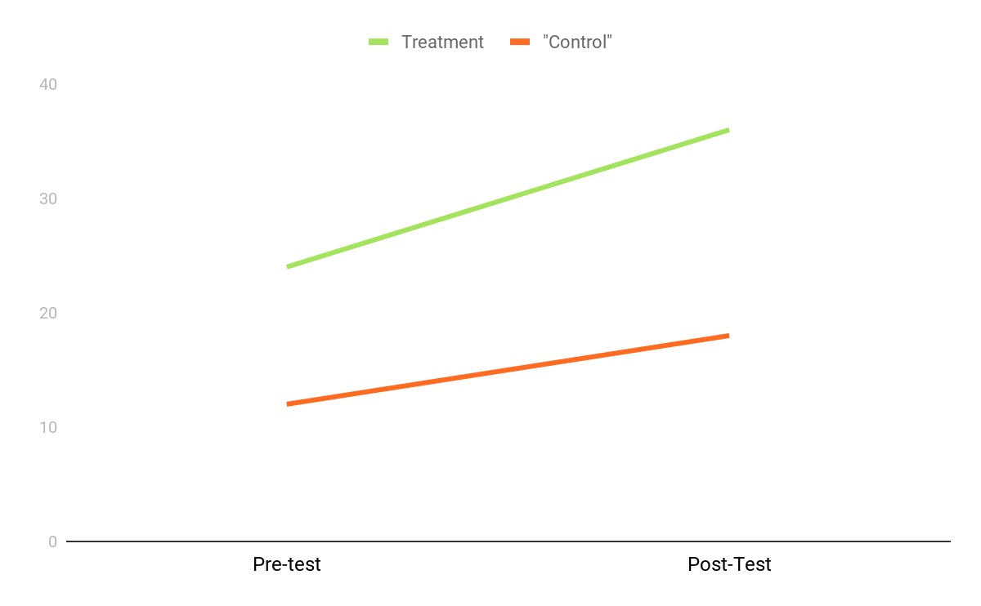
Bigger Picture

Slide 46
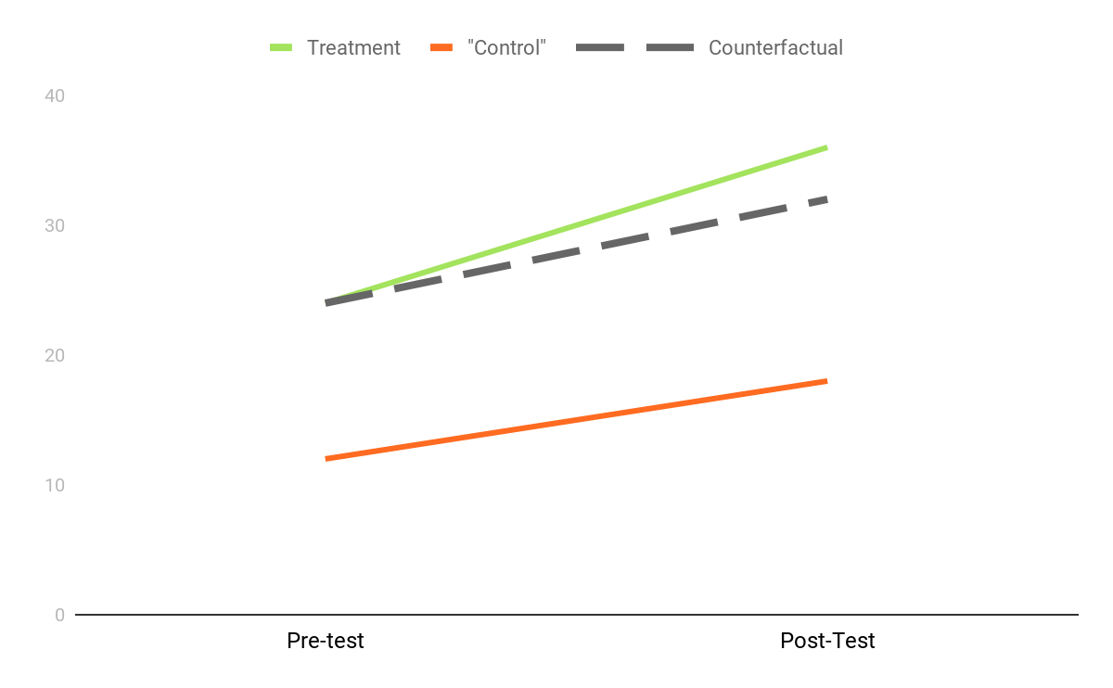
Graphical Analysis

Slide 47

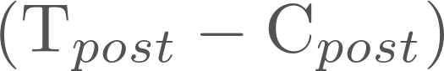
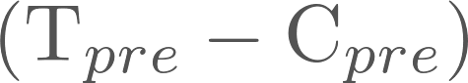
Difference in Differences

Slide 48

Difference in Differences

Slide 49
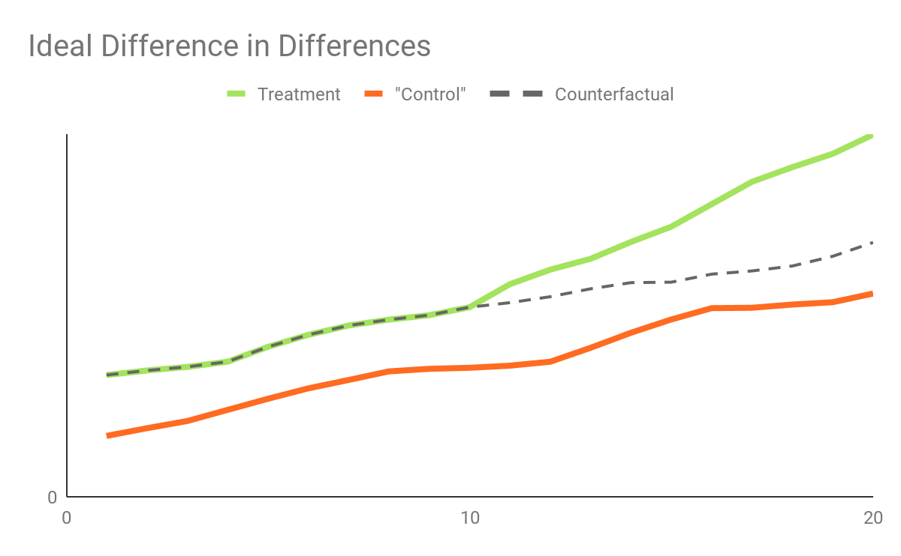
Assumptions
Common Trends
Strong Pre-Treatment Correlations
⇣
Pre-Treatment WIndow
Post-Treatment WIndow

Slide 50
Synthetic Controls
No common trend control?
Option 1: Frankenstein parts of many candidates together -- Abadie et. al 2010
Option 2: Forecast as counterfactual -- Brodersen et. al 2015 (CausalImpact)

Slide 51
Concluding thoughts

Slide 52
Correlation + Reasoning
=
Inferred Causation

Slide 53
Continually Build
Counterfactual Reasoning Expertise

Slide 54
Seeing is Believing
http://bit.ly/CausalInferenceGit

Slide 55




THANK YOU.
Bradley Fay bfay@draftkings.com
@BradleyFay
@Bradley.Fay

